Slide 1
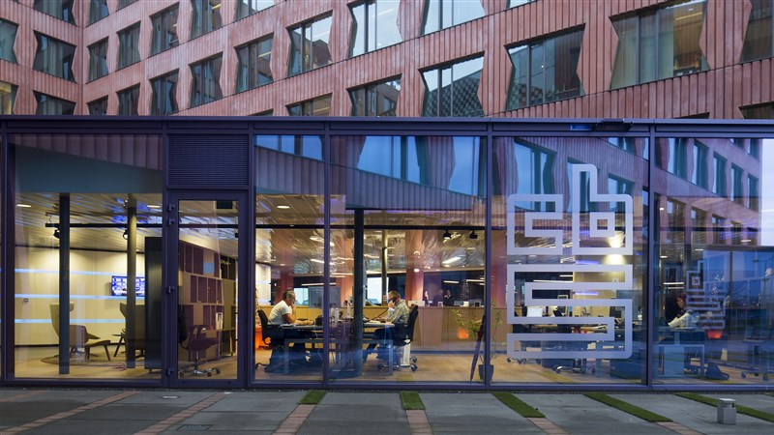
CBS Chatbot
Askin, Jan, Maliha, Niels, Seyma, Timo

Slide 2
Table of Contents
Recap
Plans & Goals
Ideas
Experiments
Findings & Conclusions

Slide 3
Recap
CBS meeting (30-8)
Data received
Datacamp
Scrum

Slide 4
Plans & Goals
Formulate potential research questions this Monday
Prepare the meeting at CBS to discuss questions & approach
Top 10 questions after cleaning data

Slide 5
Ideas
Reordering Python course
1
Finding current technologies used for text mining
2
Existing patterns & algorithms (Domain research)
3

Slide 6

Experiments
Finding patterns using ngrams

Slide 7
Findings & Conclusions
Data needs more cleaning
More research into different data mining possibilities

